Slide 1
IOT (Paintball) Sight
Students: Rafi Taub (taubrafi@gmail.com)
Nick Kuhlik (nick.kuhlik@gmail.com)
Supervisor: Moni Orbach
LAB: HSDSL EE Technion
Semester: Spring 2016-5776
Notes:
Nick

Slide 2
Motivation
The modern assault rifle sights is an optical device that is lacking in features.
The relay of tactical information in the field, back to the high command is mostly done by speech over the radio.
By integrating smart IOT devices into the gear of the modern infantry, we can transmit back vital data which can help in decision making.
Notes:
Nick

Slide 3
Goals
Create a device which integrates seamlessly into standard battle gear.
Provide meaningful information to the command chain.
Self contained, fool proof.
No burden on the user
Lightweight and low power.
Battery life of at least 24 hours
Notes:
Nick

Slide 4
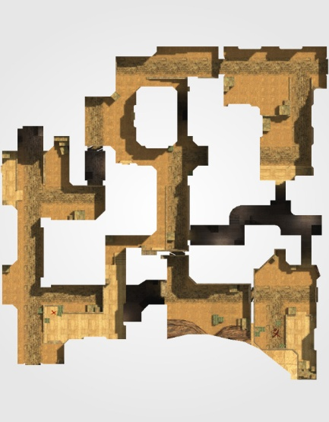

Block Diagram: Overview
Data creation
Collection and analysis
Decision making
Algorithm on the AWS cloud
GPS and MEMS data from each
HMI
Notes:
Nick

Slide 5
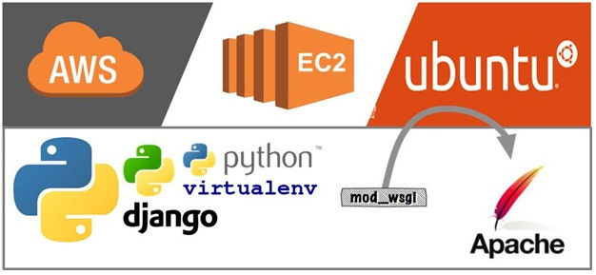
The cloud architecture
Server provider
AWS cloud
Server OS
Ubuntu
HTTP server
Apache
Web application
Written in python and js using Django and google maps api
Notes:
Nick
Next is Rafi

Slide 6
Block Diagram: Embedded Device
CC3200 MCU
Internet access: Wi-Fi
MEMS: orientation in space
GPS: location in space
Fired shot detection
SD storage
Barometer: relative altitude
Notes:
Rafi

Slide 7
Embedded software: key components
Shot fired detection
Read & process sensor data: GPS, accelerometer, magnetometer and barometer
Calculate orientation angles (roll, pitch, heading)
Unique hardware ID
Wi-Fi and connection to server
Hibernation & wakeup (power saving)
Notes:
Rafi

Slide 8
Interesting issues: magnetism
In a nutshell our project is strapping a magnetometer to a large piece of metal.
Materials exist in four possible categories:
Ferromagnetic: Ni, Fe, Steel
Paramagnetic: Sn, Al, Mg
Diamagnetic: Cu, Pb, Brass
Anti-Ferromagnetic: Cr
Each category affects magnetic fields in different ways.
Notes:
Rafi
Ni=Nickel, Fe=Iron, Sn=Tin, Al=Aluminum, Mg=Magnesium, Cu=Copper, Pb=Lead, Cr=Chromium

Slide 9


יהי $…ε>0$

Slide 10
Ideally…

Slide 11
Problem 1 - Hard iron
Magnetized Ferromagnetic materials will offset readings in a given direction.
These offsets are independent of the orientation with respect to earth.

Slide 12
Problem 1 - Hard iron

Slide 13
Problem 2 - Soft iron
Paramagnetic and diamagnetic materials attract and repel the earth’s magnetic field by creating their own internal fields
The effect changes with orientation with respect to the earth.
This results in a ‘scaling’ of the proper readings.

Slide 14
Problem 2 - Soft iron

Slide 15
Problem 3 - Both

Slide 16
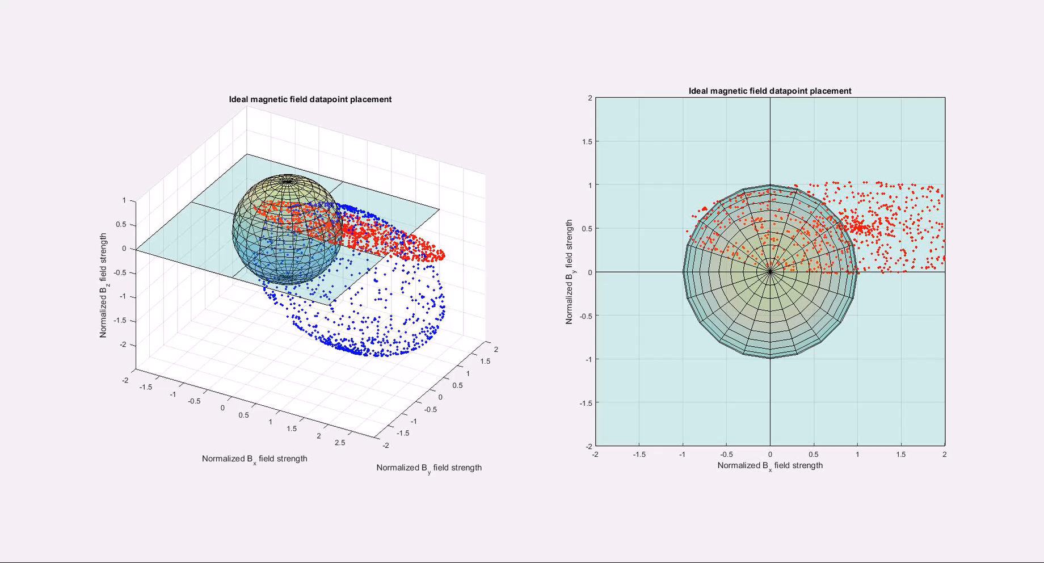
Solution

Slide 17
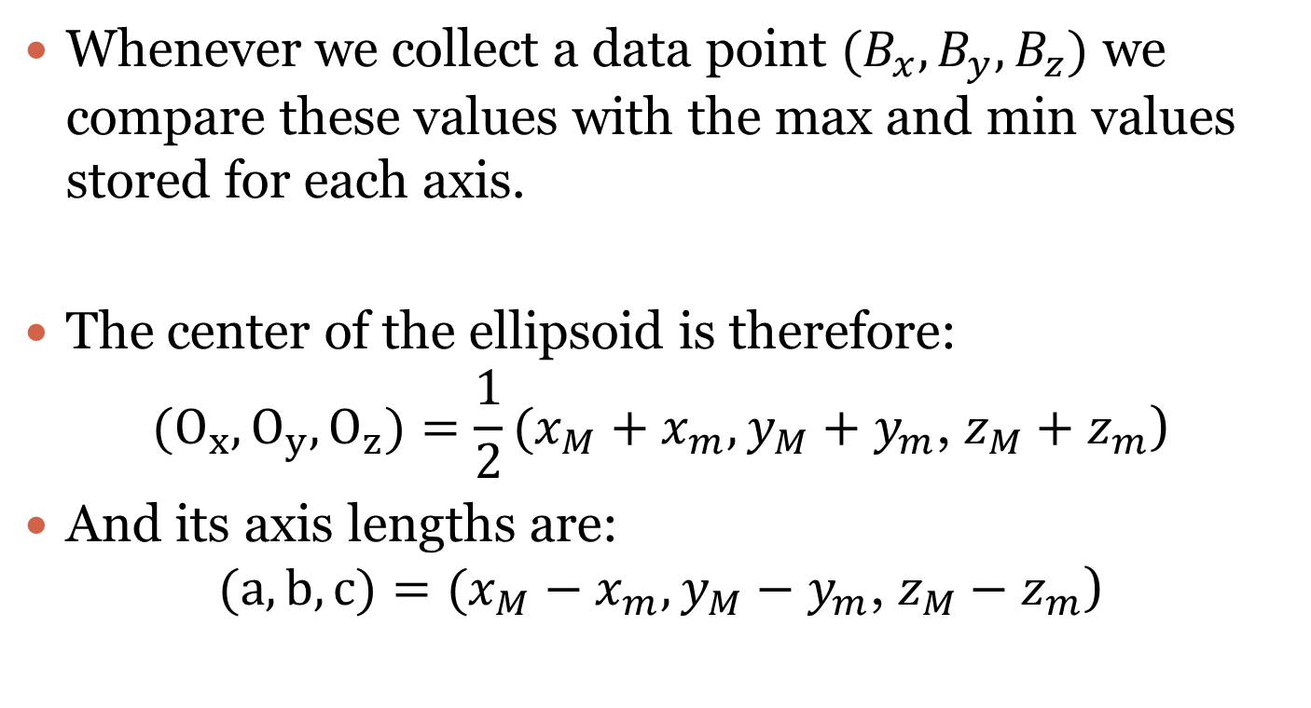
Solution
Whenever we collect a data point $(B_{x},B_{y},B_{z})$ we compare these values with the max and min values stored for each axis.
The center of the ellipsoid is therefore: $(O_{x},O_{y},O_{z})=\frac{1}{2}(x_{M}+x_{m}, y_{M}+y_{m}\text{, }z_{M}+z_{m}\text{)}$
And its axis lengths are: $(a,b,c)=(x_{M}−x_{m}, y_{M}−y_{m}\text{, }z_{M}−z_{m}\text{)}$

Slide 18
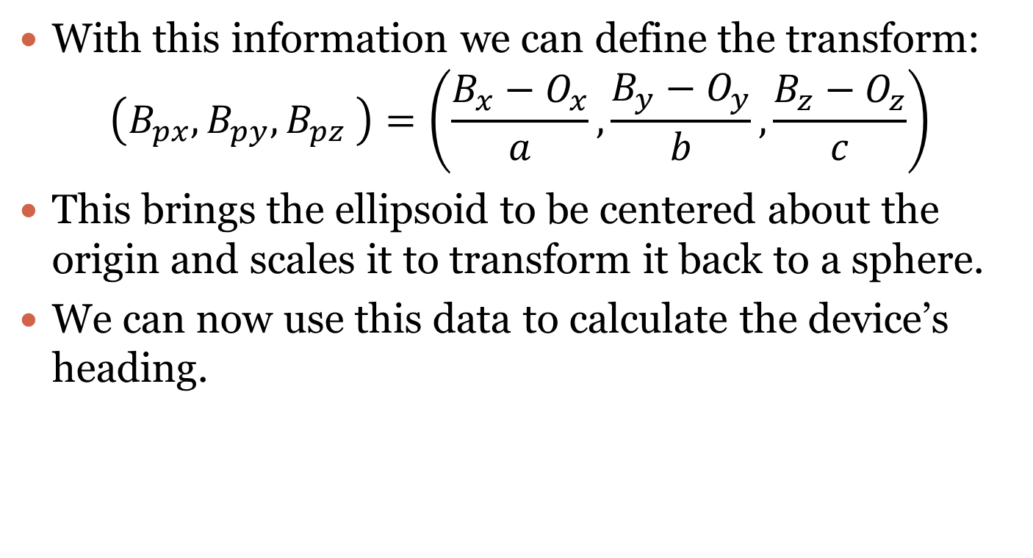
Solution
With this information we can define the transform: $\left(B_{px},B_{py},B_{pz} \right)=\left(\frac{B_{x}−O_{x}}{a},\frac{B_{y}−O_{y}}{b},\frac{B_{z}−O_{z}}{c}\right)$
This brings the ellipsoid to be centered about the origin and scales it to transform it back to a sphere.
We can now use this data to calculate the device’s heading.

Slide 19
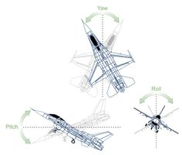
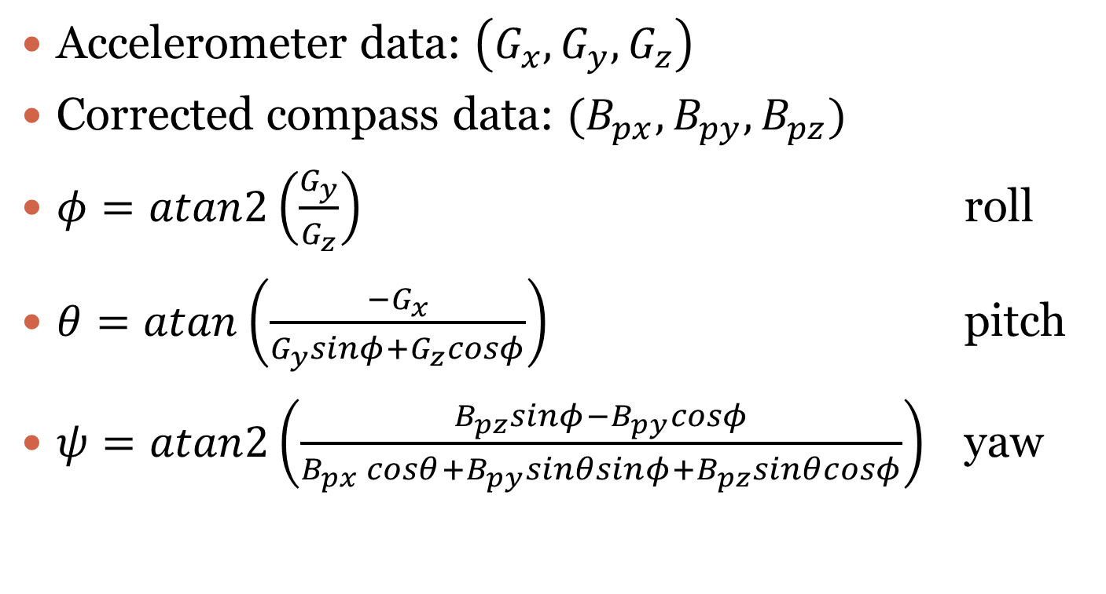
Orientation mathematics
Accelerometer data: $\left(G_{x}, G_{y}, G_{z}\right)$
Corrected compass data: $(B_{px}, B_{py}, B_{pz})$
$φ=atan2\left(\frac{G_{y}}{G_{z}}\right)$ roll
$θ=atan\left(\frac{−G_{x}}{G_{y}sinφ+G_{z}cosφ}\right)$ pitch
$ψ=atan2\left(\frac{B_{pz}sinφ−B_{py}cosφ}{B_{px} cosθ+B_{py}sinθsinφ+B_{pz}sinθcosφ}\right)$ yaw

Slide 20
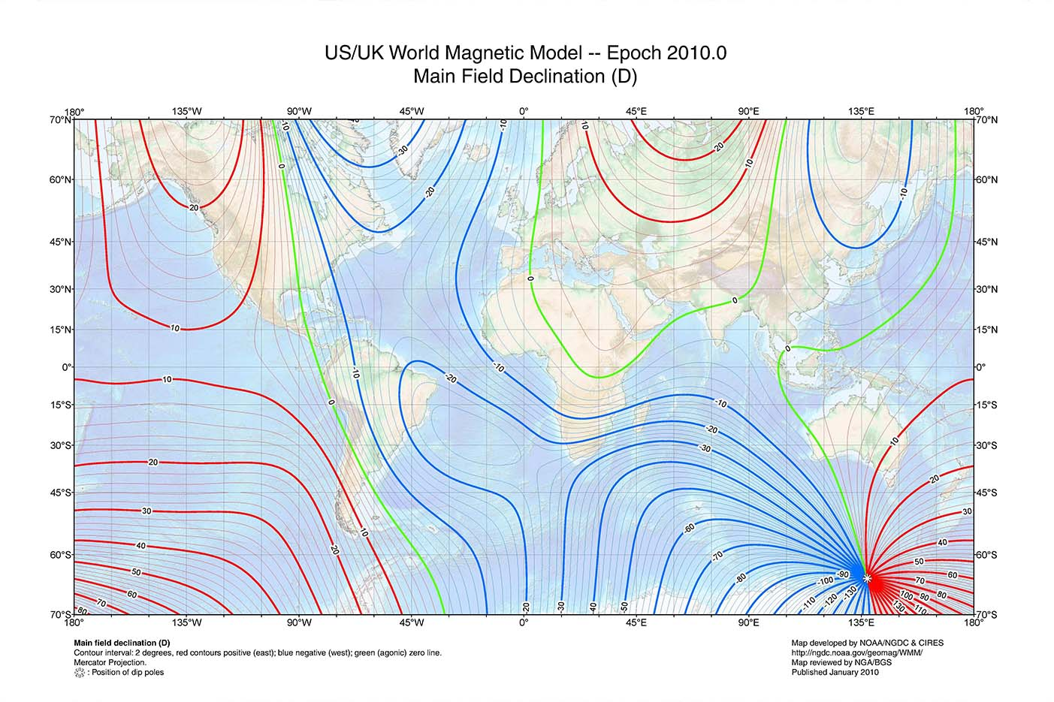
There’s always more math
Notes:
Rafi

Slide 21
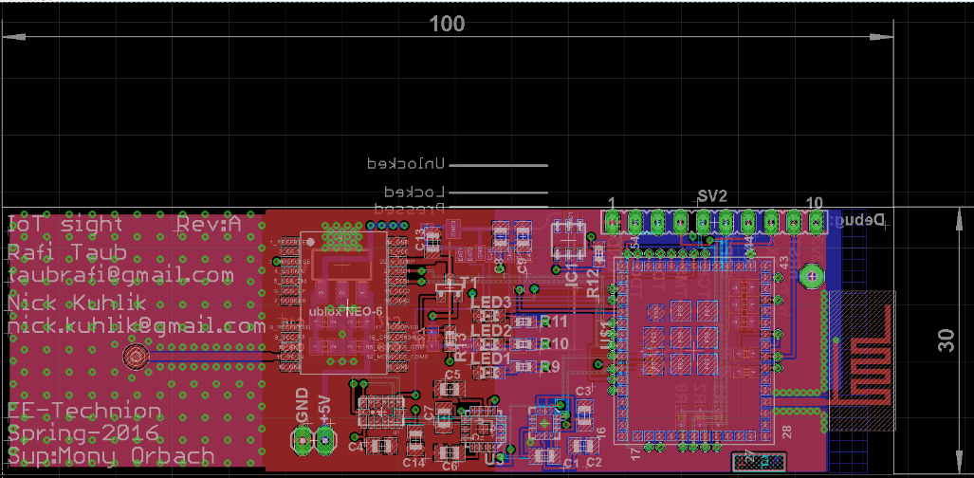
Results: PCB Design
Designed in Eagle, four layer PCB

Slide 22
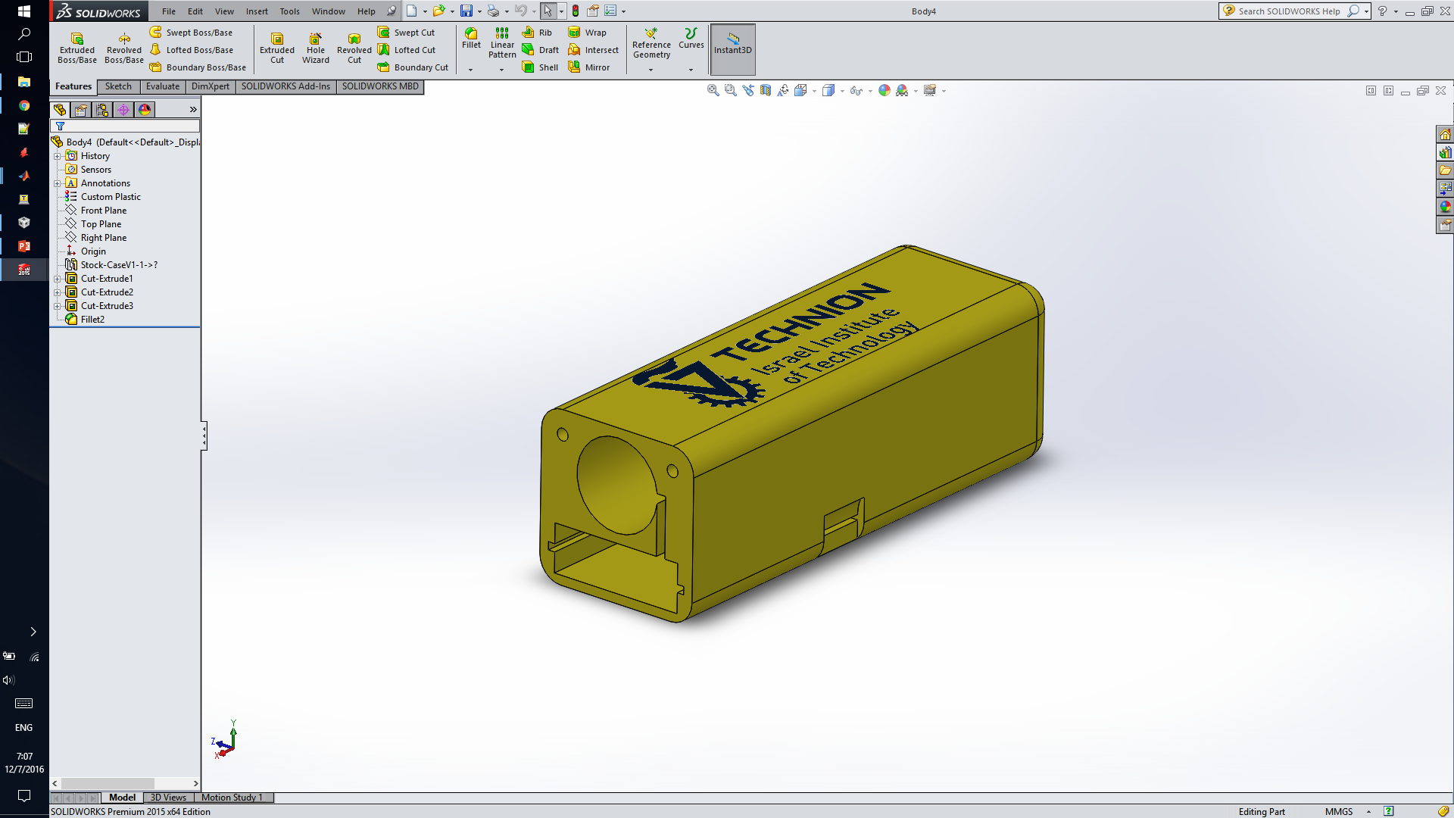
Results: Enclosure design
Designed in solidworks, 3d printed in PLA
There are better options than 3d printing

Slide 23
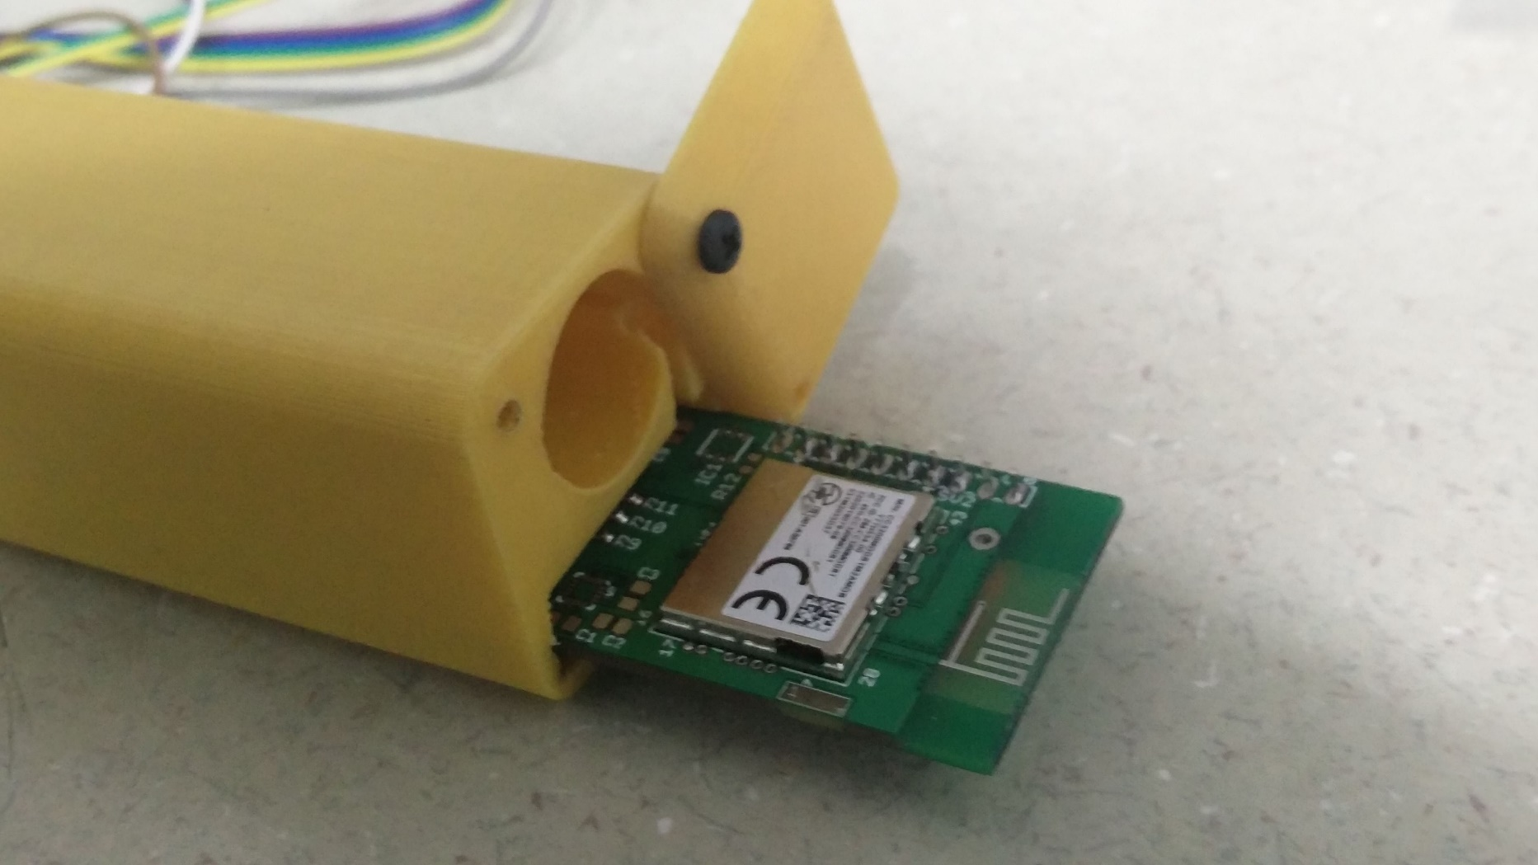
Results: Enclosure
Notes:
Rafi

Slide 24
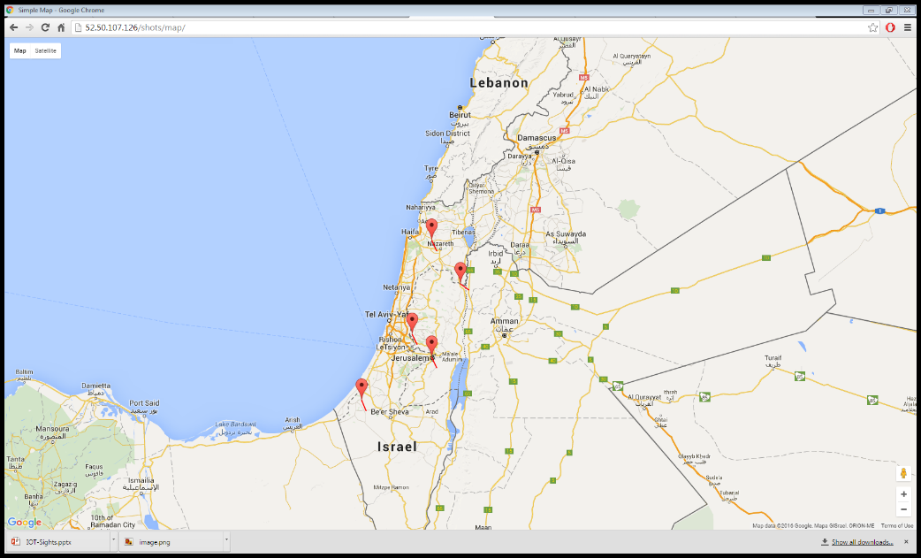
Results: The cloud
Site is located at http://52.50.107.126/ using AWS cloud.
Code is located at https://github.com/sudo-Whateverman/IOTsights

Slide 25
Tests
Sensors: GPS, accelerometer, magnetometer, barometer.
Nearly entirely based on the manufacturer and we need to only ‘confirm’ their results.
Battery life
Trigger testing

Slide 26
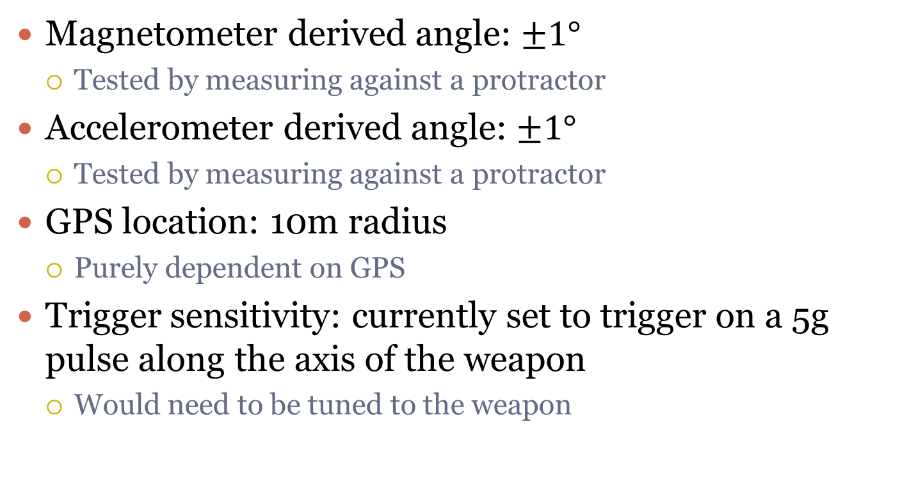
Sensor test results
Magnetometer derived angle: $±1°$
Tested by measuring against a protractor
Accelerometer derived angle: $±1°$
Tested by measuring against a protractor
GPS location: 10m radius
Purely dependent on GPS
Trigger sensitivity: currently set to trigger on a 5g pulse along the axis of the weapon
Would need to be tuned to the weapon
Notes:
Rafi

Slide 27
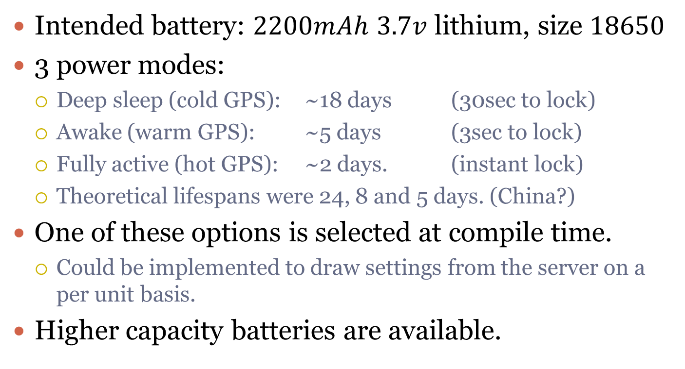
Power consumption
Intended battery: $2200mAh$ $3.7v$ lithium, size $18650$
3 power modes:
Deep sleep (cold GPS): ~18 days (30sec to lock)
Awake (warm GPS): ~5 days (3sec to lock)
Fully active (hot GPS): ~2 days. (instant lock)
Theoretical lifespans were 24, 8 and 5 days. (China?)
One of these options is selected at compile time.
Could be implemented to draw settings from the server on a per unit basis.
Higher capacity batteries are available.
Notes:
Rafi

Slide 28
Demo!
http://52.50.107.126/shots/

Slide 29
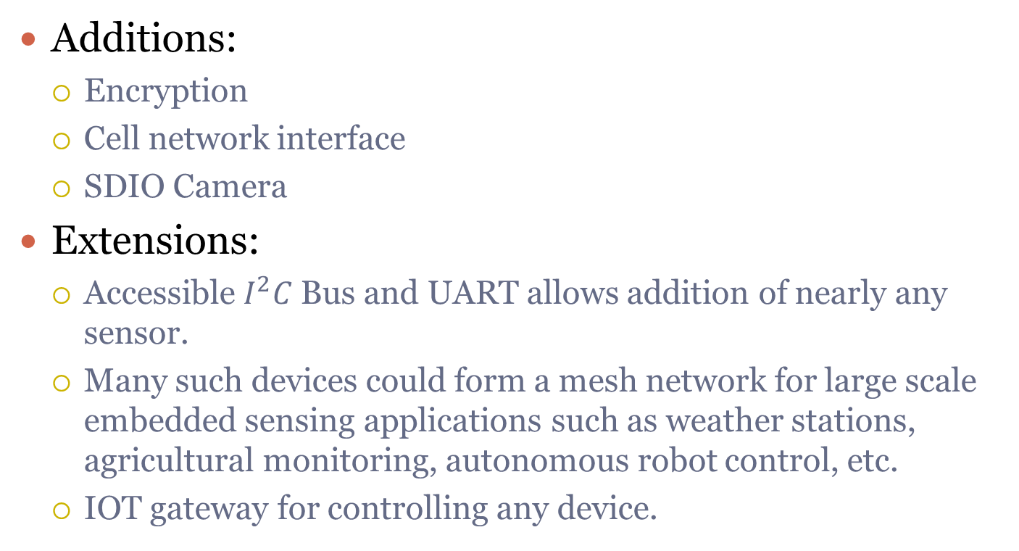
What else?
Additions:
Encryption
Cell network interface
SDIO Camera
Extensions:
Accessible $I^{2}C$ Bus and UART allows addition of nearly any sensor.
Many such devices could form a mesh network for large scale embedded sensing applications such as weather stations, agricultural monitoring, autonomous robot control, etc.
IOT gateway for controlling any device.
Notes:
Rafi

Slide 30
Project expansion: scalability
The AWS platform gives the means to configure the deployment of several virtual machines automaticaly.
Aws is monitoring the cpu usage/bandwith/disk usage.
When a certain threshold that was set up is passed the group is expanded.
When the threshold is passed on the way down, the group is shrinked and a machine is deactivated.
This creates a solution that responds quickly to abrupt surges in usage.
Notes:
Nick

Slide 31
Project expansion: bootimage over internet
In order to succesfully update the software over internet we must implement:
Bootimage scratch space in RAM.
Checksum of the image for validation.
Secure transmit of the data to deter reverse engineering.
Thus we shall be able to create a decentralized solution that is future proof and shall be easily upgraded in the future.
Notes:
Nick

Slide 32
Thank you!
Special thanks to Mony, for his assistance, advice and feedback.

Slide 33
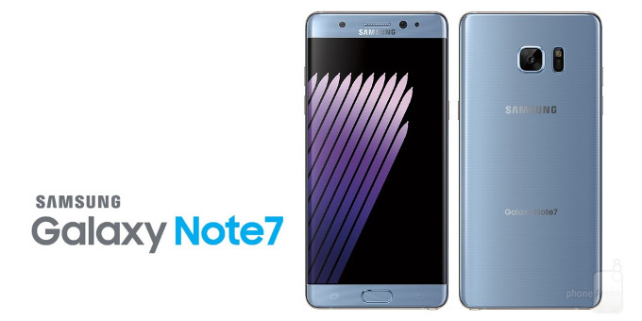
About those Li-ion batteries…

